Slide 1
Session 15 and 16

Slide 2
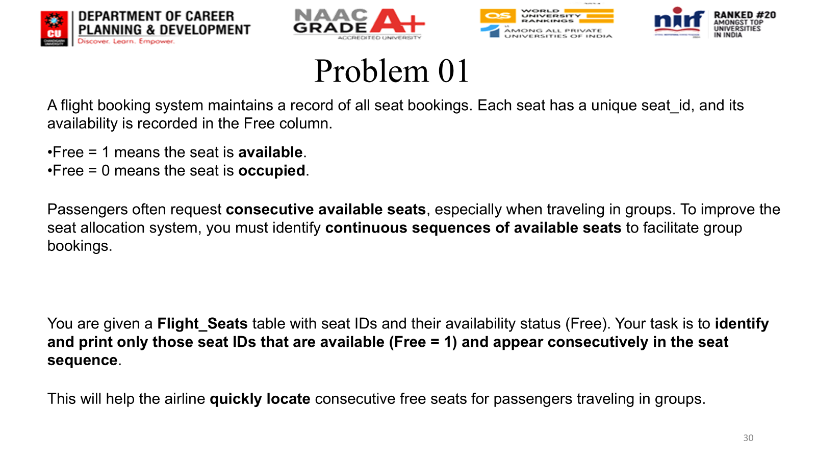
Session 13

Slide 3
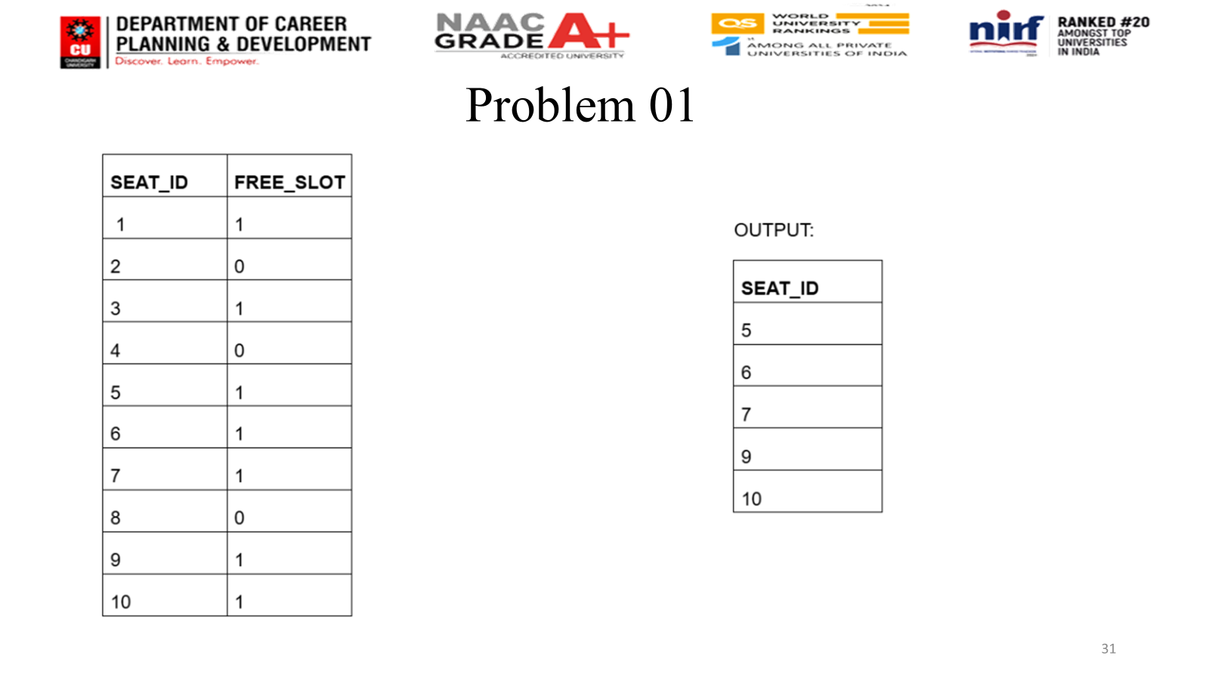
Session 13

Slide 4
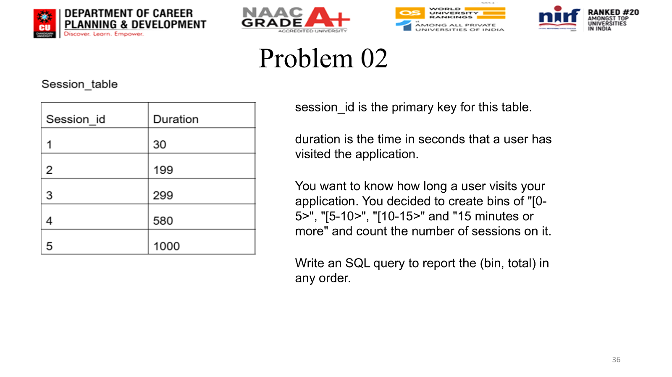
Session 14

